Slide 1
IOT Smart Lights

Slide 2
Who am I
I’m Jim Fitzpatrick
Currently I study at WIT in Waterford
You can find me on Twitter @boomatang
Or on telegram @boomatang

Slide 3
IOT Smart Lights Aims To
Remove the dependence on expensive smart bulbs.
Remove the need to for propriety light switches.
Give the owner the choice of style switch they use.
Create a easily extendable model if the owner wishes to expand.

Slide 4
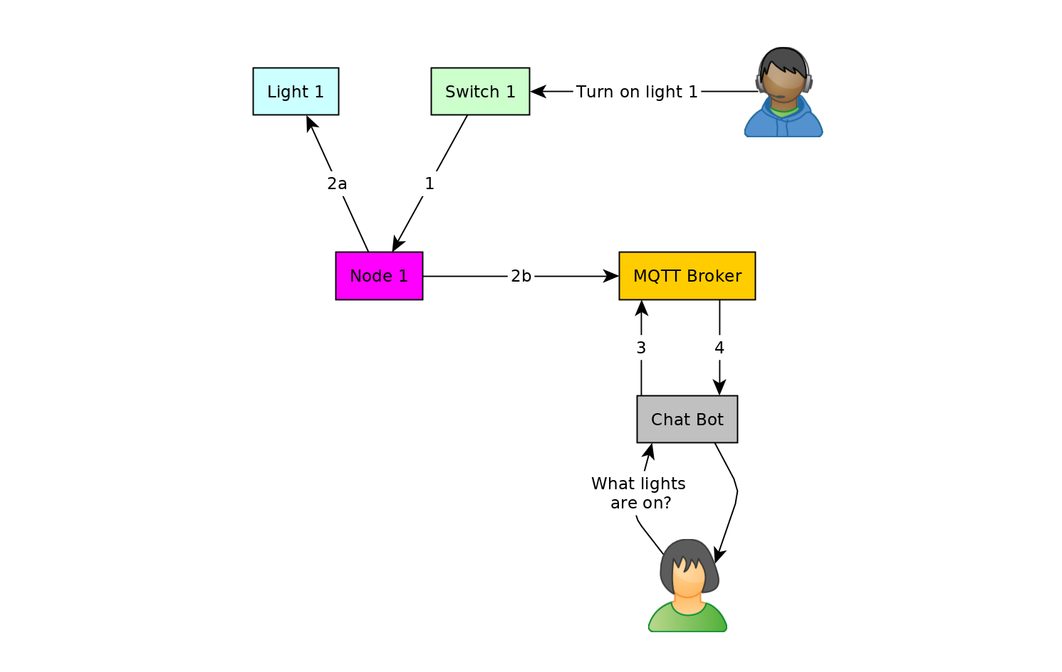
Light & switch connected to same node
A user turns on a switch that is connected to the local node
a. The node sends a signal to turn on the light. As the node is connected directly to the light this powers the light.
b. The node sends a signal to the MQTT Broker updating the status saying the light is turned on
By request of the user the chat bot asks the MQTT Broker for the status of all the lights.
The MQTT Broker reply's to the chat bot with the status of the lights and now the user is informed

Slide 5
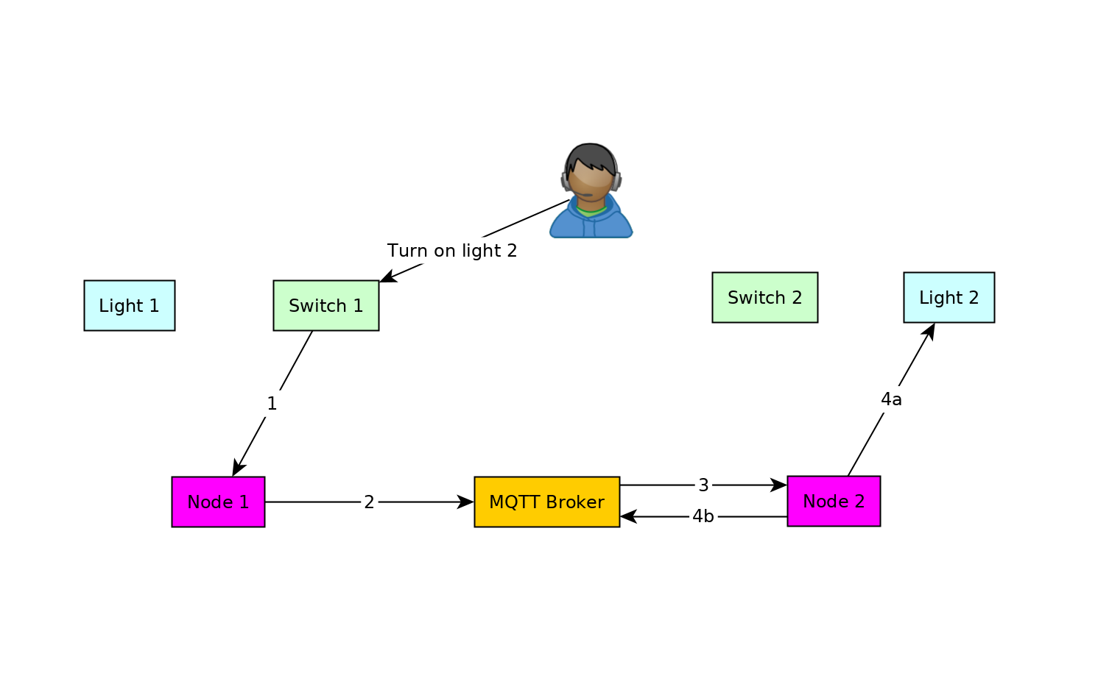
Switch turns on remote lights
The user switches on the light L2 that is not connected to Node 1
Node 1 sees that light L2 is a remote light. Now Node 1 sends a command to the MQTT Broker stating that light L2 should be turned on.
The MQTT Broker now publishes the command to turn on the light L2
a. Node 2 picks up the command to turn on the light L2. As the node is connected directly to the light this powers the light.
b. Node 2 updates the status on the MQTT Broker to say the light L2 is on.

Slide 6
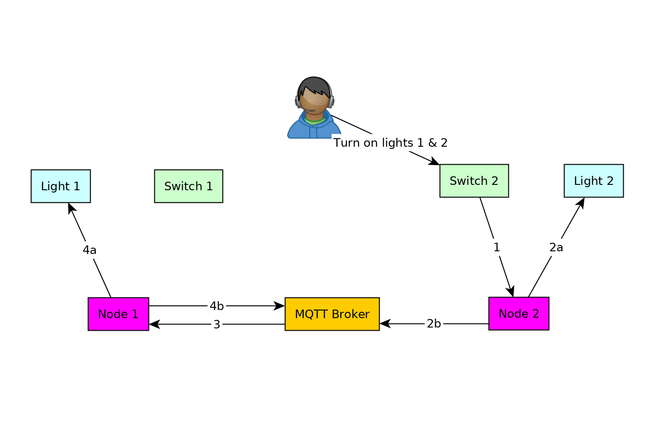
One switch to turn on multiple lights
The user switches switch 2 on which has be programmed to turn on light 1 & 2. A signal is sent to Node 2.
a. Light 2 is connected to Node 2 and is powered on
b. N2 sends a message to the MQTT Broker with a command to turn on light 1 and a status update saying light 2 has been turned on.
The MQTT Broker now publishes the command to turn on the light L1
a. Node 1 picks up the command to turn on the light L1. As the node is connected directly to the light this powers the light.
b. Node 1 updates the status on the MQTT Broker to say the light L1 is on.

Slide 7
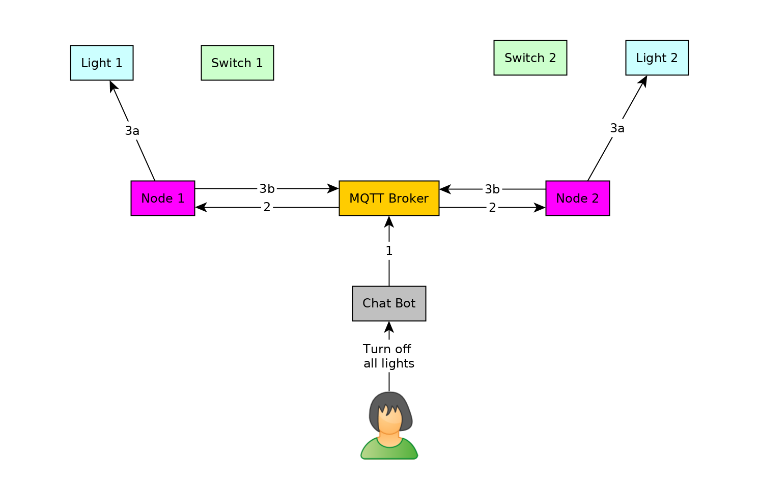
Chat Bot used to turn off all lights
The user sends a message from the chat bot to turn off all the lights.
The MQTT Broker publish a massage to all nodes to turn off their lights
a. Each node turns off their lights
b. Each node updates the status of their lights with the MQTT Broker

Slide 8
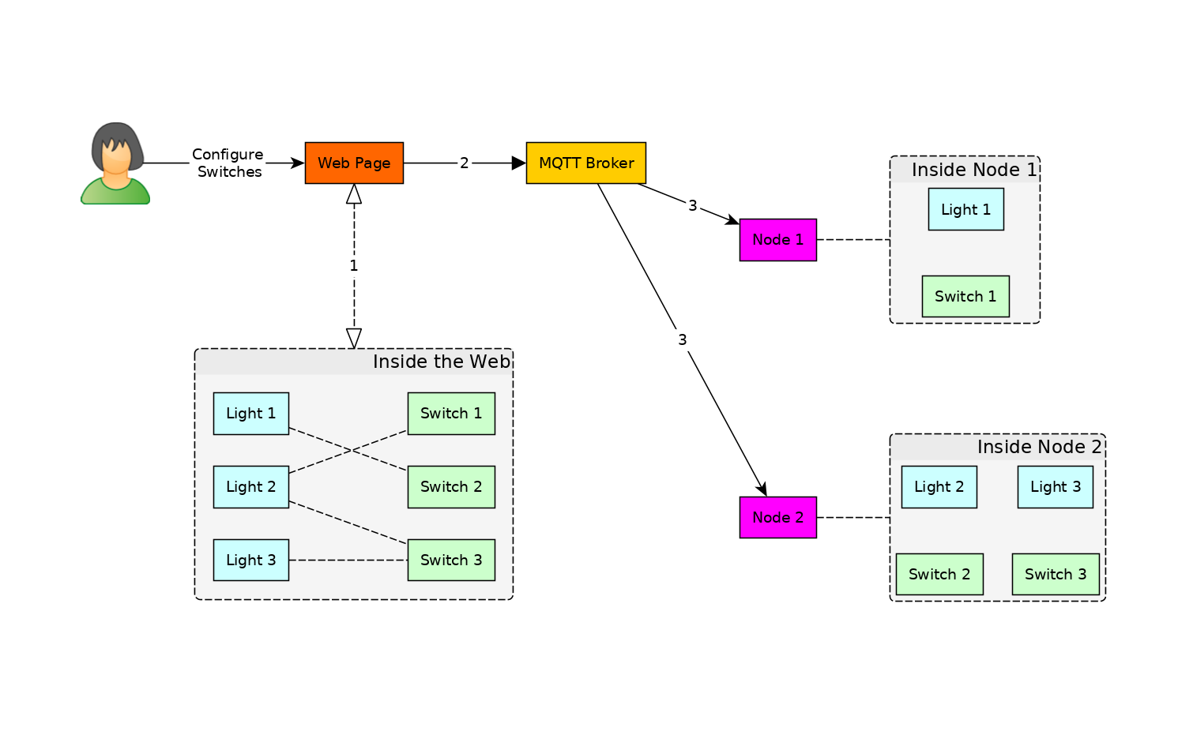
Configure lights and switches
The user configures what switches is used to turn on which lights using the web interface.
The web interface sends a message to the MQTT Broker with the new configuration
The MQTT Broker publish the new configuration to the nodes. Which update their local configurations for the switches.

Slide 9
To Recap
A node can control local lights
A switch can control multiple local and remote lights
Chat bots are used to interact with the system
The web interface is used to configure the system

Slide 10
Get Involved
The source code can be found on github at https://github.com/Boomatang/iot-smart-lights

Slide 11
Thank
You

